Slide 1
Tør du slippe brukerne løs på Teams og Groups uten kontroll?
Ståle Hansen Principal Cloud Architect Cloudway As
Mikael Svenson CTO Puzzlepart

Slide 2







Mikael Svenson MVP Office Servers and Services

Slide 3



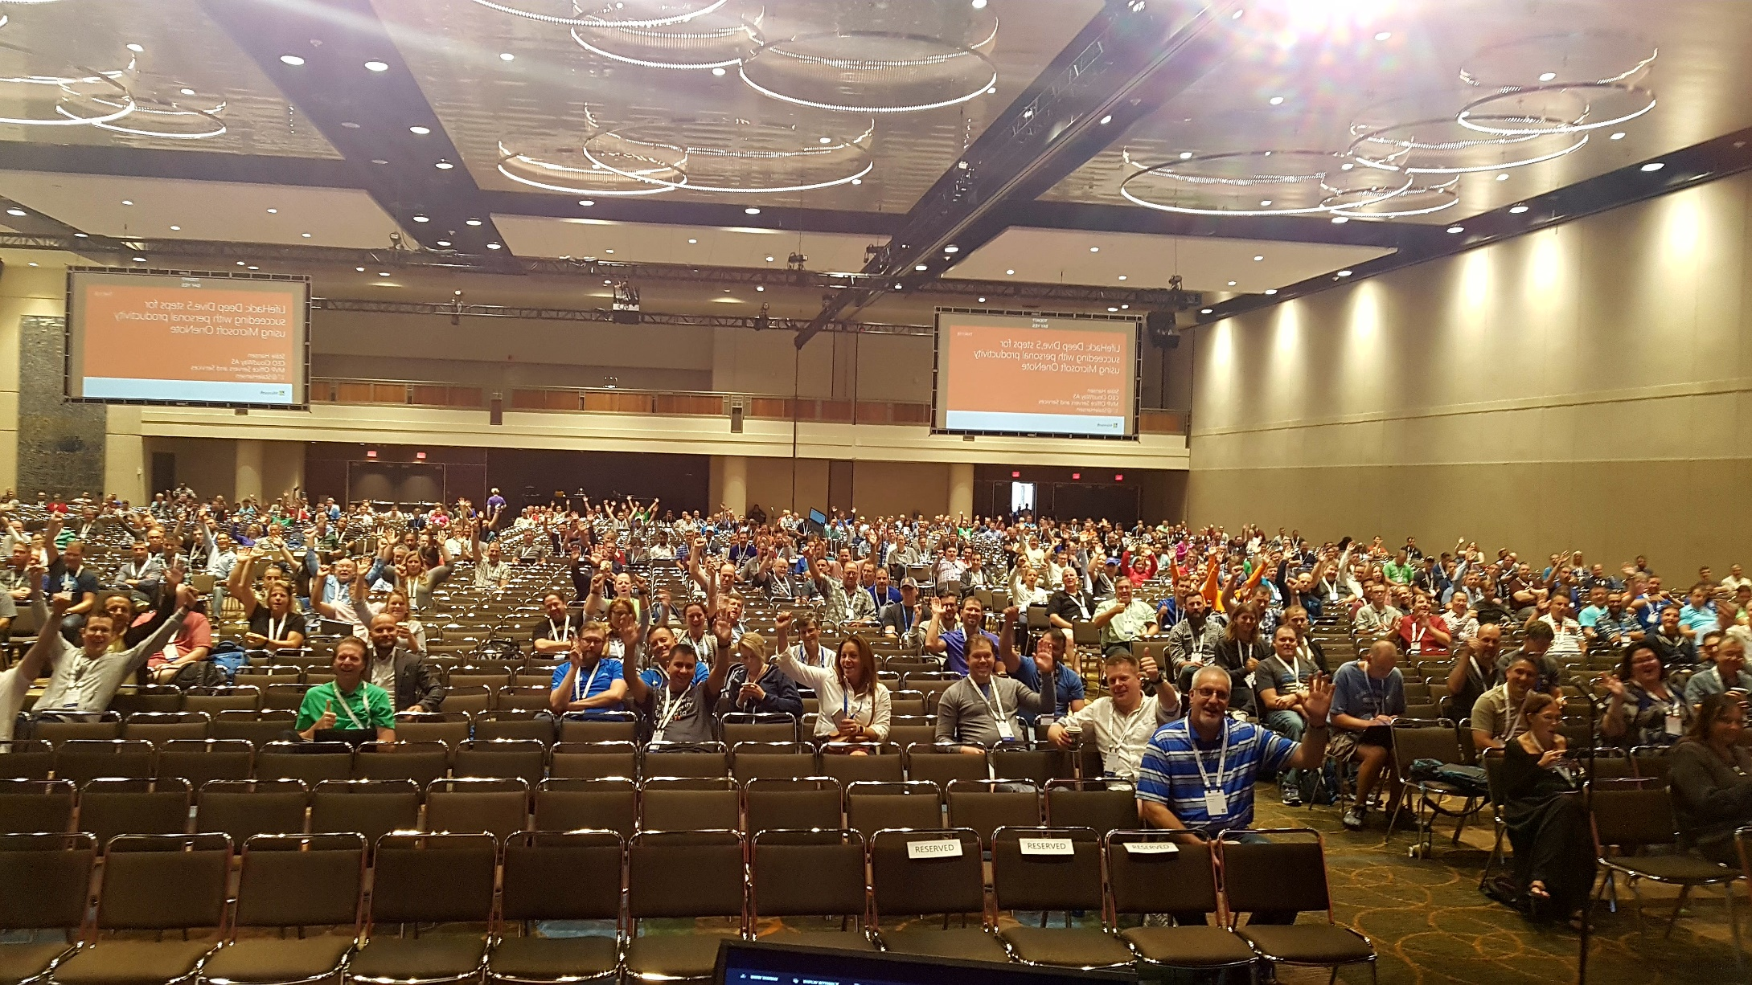
Ståle Hansen - MVP Office Servers and Services Founder & Principal Cloud Architect

Slide 4
The problem - no one solution fits all scenarios
Rules and regulations
Governance
Tools
Metadata
Look and feel
Etc…
Notes:
Out of the box is fine, but often it won’t suit every need. Which is why people have been customizing and configuring SharePoint for so long.

Slide 5

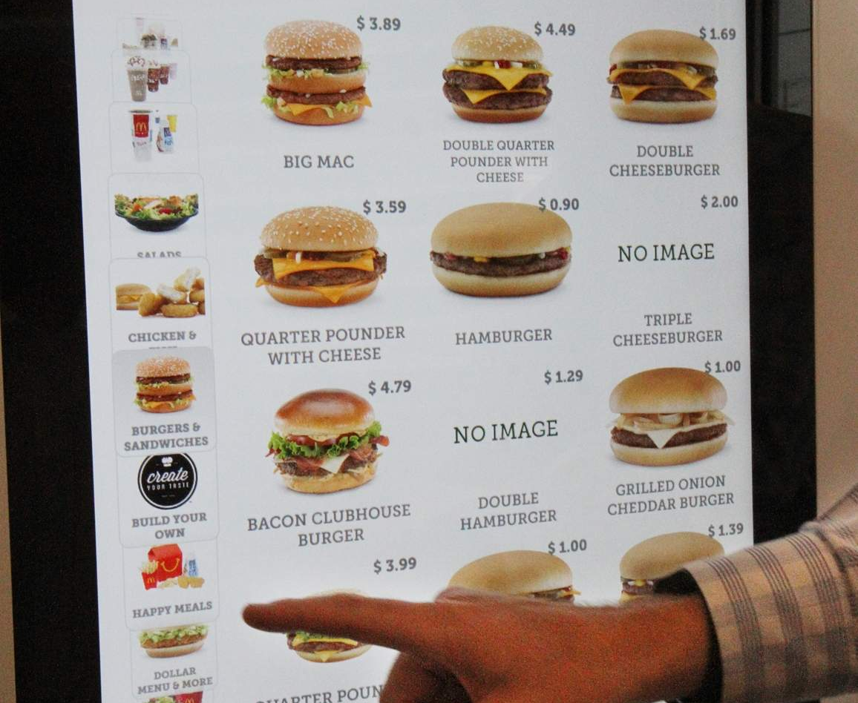
Self-service vs. Self-service
Notes:
OOB Groups is a full on-buffet, grab while it lasts – while we want the same thing, but with controlled options. You cannot have a cheeseburger without cheese, you need a hamburger with added cheese.

Slide 6


Lock-down in progress!

Slide 7
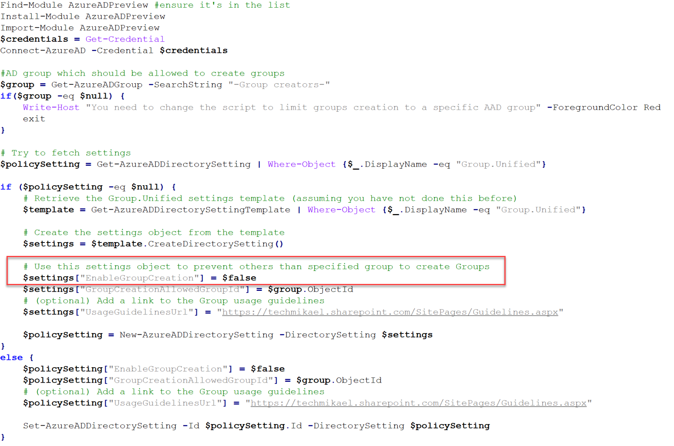
Lock down out of the box self service
Notes:
First order of business is to lock down the OOB experience to a select few.

Slide 8
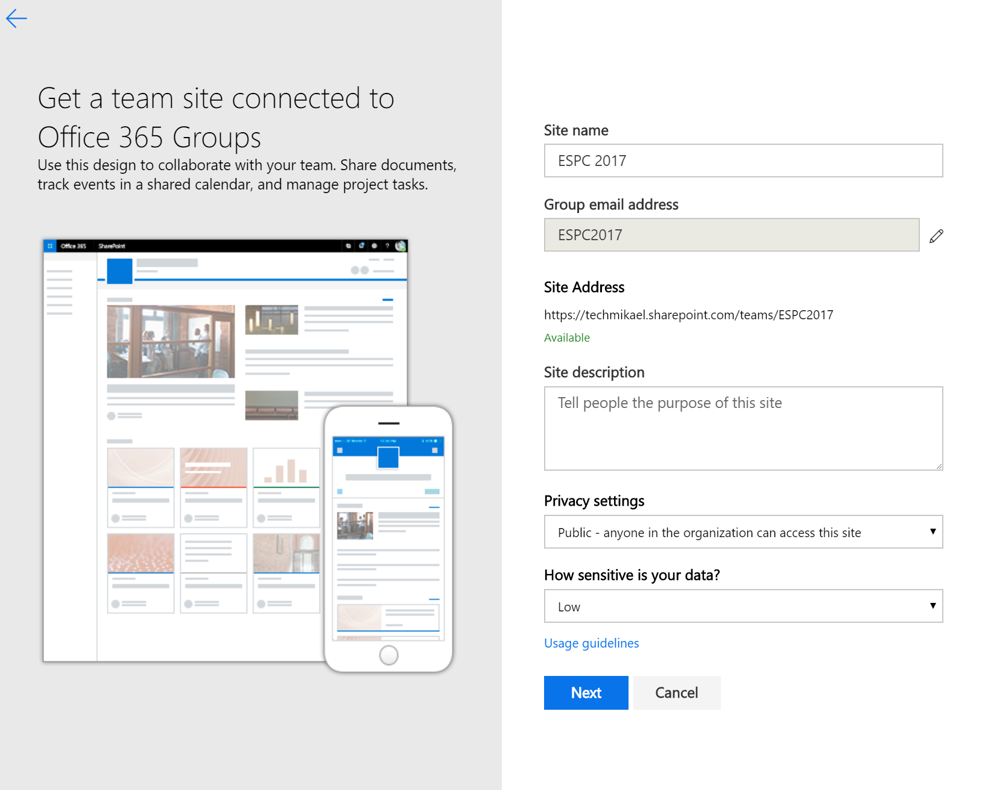
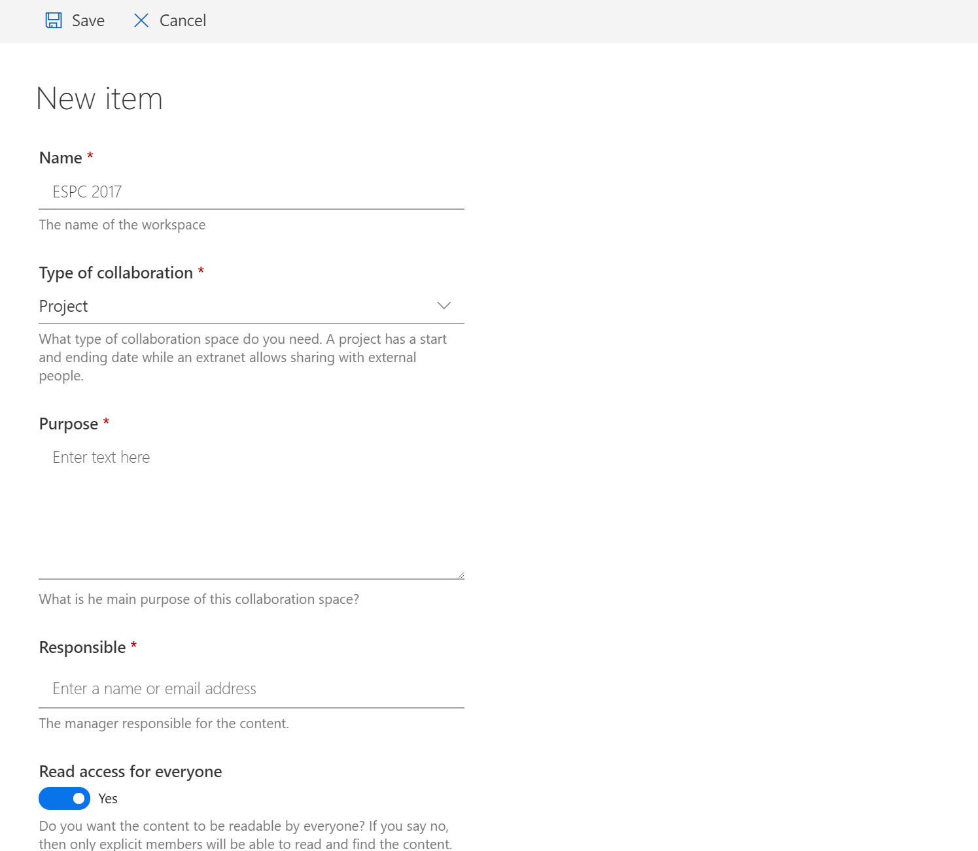
Out-of-the-box form
Custom form – anything you like
Notes:
Few fields, no control or metadata vs. anything you need.
Create the form however you want – PowerApps, code, Microsoft Forms

Slide 9
Group naming
Out of the box
ONE pattern
AAD attributes and text
Manual e-mail edit
Group MVP 2018 Oslo
GroupMVP2018Oslo@

Slide 10
Group naming
Out of the box
Custom
ONE pattern
AAD attributes and text
Manual e-mail edit
Group MVP 2018 Oslo
GroupMVP2018Oslo@
ANY pattern
Project: MVP 2018
project-MVP2018@

Slide 11
Group naming
Out of the box
Custom
ONE pattern
AAD attributes and text
Manual e-mail edit
Group MVP 2018 Oslo
GroupMVP2018Oslo@
ANY pattern
External: MVP 2018
external-MVP2018@

Slide 12
Group naming
Out of the box
Custom
ONE pattern
AAD attributes and text
Manual e-mail edit
Group MVP 2018 Oslo
GroupMVP2018Oslo@
ANY pattern
Team: MVP 2018
team-MVP2018@

Slide 13
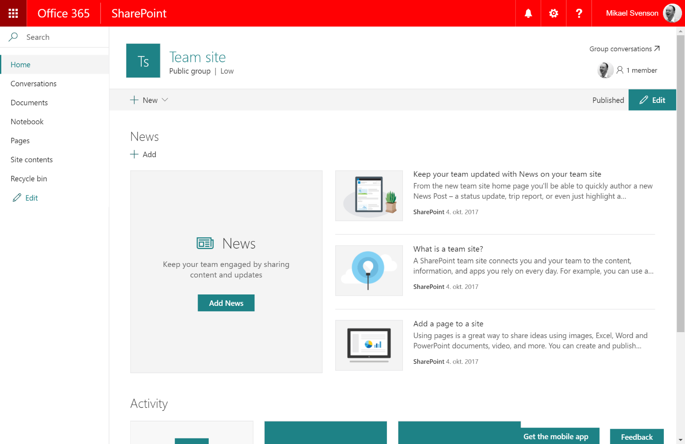
Templating

Slide 14
Notes:
Out of the box design

Slide 15
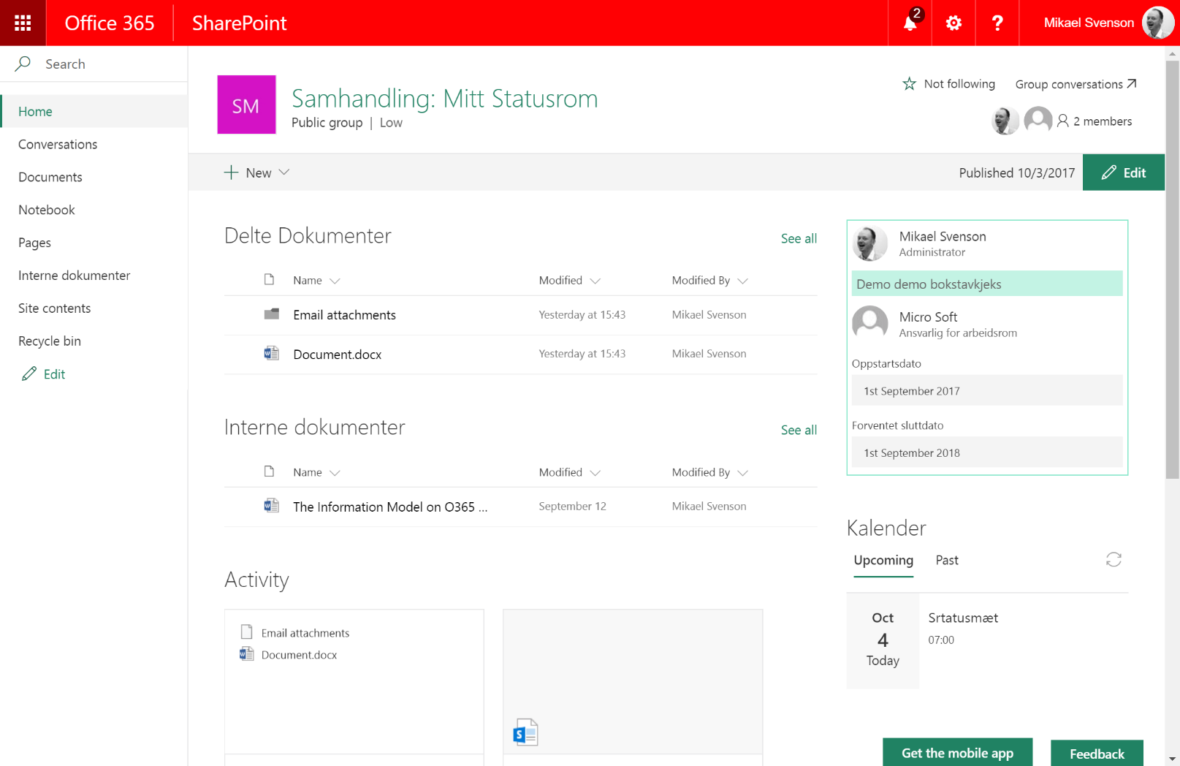


Slide 16
Templating
Notes:
Custom template with web parts suiting the business need

Slide 17

How can I get there?

Slide 18
PowerShell ☺ _

Slide 19
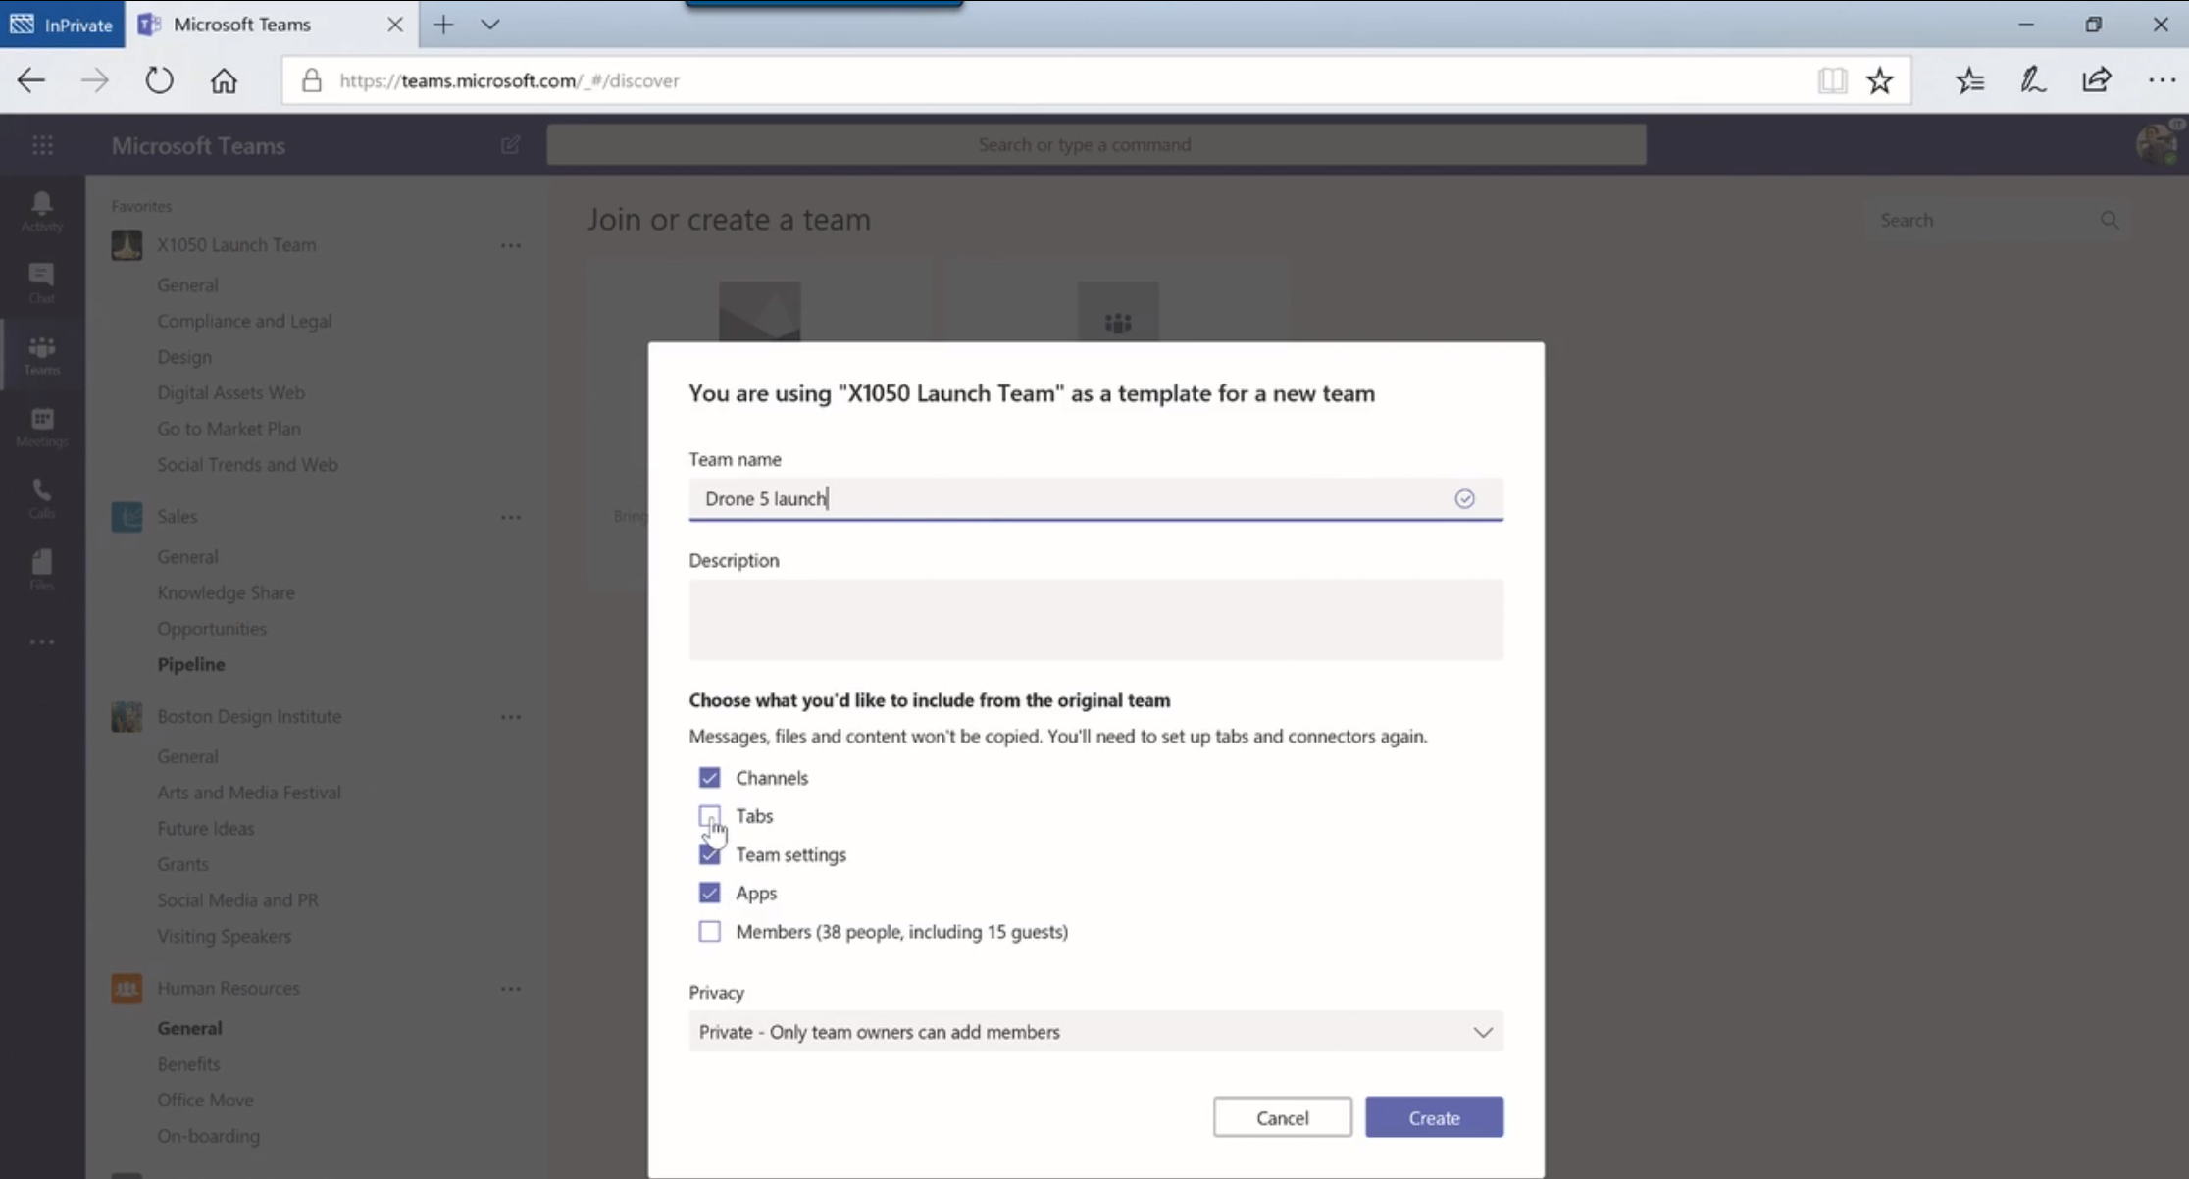
Create a team based on a team (rolling out)

Slide 20
What Do I get OOB?

Slide 21
Azure AD Premium 1 gives you..
One license per admin
Turn on/off self-service
Set classification options
Set guidance link
Create dynamic groups (dynamic groups does currently not allow Teams)
One license per user affected by
Member in a dynamic group
Group using naming policy
Group having expiration policy
See https://docs.microsoft.com/en-us/azure/active-directory/active-directory-accessmanagement-groups-settings-cmdlets#template-settings

Slide 22
Reporting and Decomission

Slide 23














Skype for Business Plan2
Required for:
Interop for Skype and Teams
Phone System
Calling Plan
PSTN Conferencing
Hybrid chat/Presence
…
Exchange Online Plan for Tenant
Exchange on-premises Ex2016 CU3 required for:
Meetings TAB/Profile Photo
…
SharePoint Online for Tenant
Users don’t need SharePoint license to create or use Teams sites.
O365 Information Protection tools
eDiscovery
Legal Hold
Compliance content search
Archive
Retention
Audit Logs
Plans
User
mailboxes
SharePoint license required for:
sharing files in 1:1 chat
User OneDrives
Internal Networks
Sites, Lists, Libraries
Skype Meeting
Broadcast
Buckets
Calendars
External Networks
O365 Video Portal
Voice, Video
Group
conversations
Group Files
…
Tasks
…
…
…
Group Notebook
Online Meetings
Group
mailboxes
Attachments
Group
calendars
Channel Files
Voice, Video,
Meetings
Task comments
Phone System, Calling Plans, Audio Conferencing
1:1 Chat
N:N Chat
Channel Chat

Slide 24
Reporting – What can we find out?
Check activity in Outlook Group mailbox
Check activity in Teams channel chat
Check activity in SharePoint teamsite
Check if ownerless
Other stuff to check, stream, PowerBI, Planner

Slide 25
Delete vs archive
If it is ok to delete, use expiration policy
Days | Action
1 | Group created (or renewed).
335 | First expiry notification sent to group owners.
350 | Second expiry notification sent to group owners
364 | Final warning sent to group owners
365 | Expiry period reached. Office 365 soft-deletes the group.
395 | 30-day soft-delete retention period expires. Office 365 removes the group permanently.

Slide 26
Archive
Add service account or compliance officer to group as owner
Remove alle owners and members
Change primary SMTP address to same name with an archive prefix
Set access type to private
Set require sender authentication
Hide from Outlook addresslist
Add custom attribute Archived
Add custom attribute date

Slide 27
restore
Use Azure AD PowerShell module
If soft deleted you can restore everything
If purged after 30 days, you can maybe restore bits and pieces

Slide 28
Custom or OOB?
Define all your business criteria
Make up your mind

Slide 29




Tusen Takk for oss!
#MVPdagen
http://mvpdagen.no

